Slide 1
Strengthening Father-Son Communication
Sexual Behavior
Fathers and Sons Program
© 2022 The Regents of the University of Michigan
Notes:
Facilitator Script
(Read the text in the boxes as you go through the PowerPoint slides)
Today we are going to talk about how you and your dad can talk to each other about a hard topic—sex.

Slide 2
Let’s Talk About Sex
Who? Your Dad
How? Ask Questions
When? Now
Why? Children who talk to their dads know what to do when they have to make a decision.
© 2022 The Regents of the University of Michigan
Notes:
Raise your hand if you find talking to your dad about some subjects hard.
What are the harder subjects to talk with him about?
(WAIT FOR RESPONSES)
Thank you for sharing. A lot of young men find it hard to talk with their fathers about things that have to do with sex like the changes going on with their bodies and how they feel about girls. Your father loves you and wants what is best for you—this makes him the right person to talk to about anything including sex. As an adult your father has more life experience than you and can give you solid advice and get the correct answers to your questions.
Talking to your dad about sex might be embarrassing at first, but the more you talk the easier it will become. Don’t let embarrassment prevent you from getting the information that you need to make healthy decisions.

Slide 3
1.
Some Facts…..
51.5% of African American teens report that they have never had sex¹
40% of teenaged African American males report that they were NOT sexually active¹
It’s OK to just be friends with a girl
© 2022 The Regents of the University of Michigan
Notes:
Young people are curious about how other young people behave. We have gathered some facts about the sexual behavior of people your age.
In 2015, 51.5% of African American teens reported that they have never had sex and 40% of African American male teens reported that they are NOT sexually active.¹ This means that most African American teenagers are NOT having sex. They realize that sex is an adult behavior that you should not be doing until you are older. Emotional and physical harm can result from having sex too early in life. At this stage of life you should be focused on developing friendships and building your academic and social skills.
Kids who end up having sex before they are ready have to deal with a lot of things that they are not prepared for. Can you give me some examples of what they might be?
(WAIT FOR RESPONSES)

Slide 4
What’s wrong with having sex too early?
Unwanted pregnancy
HIV/AIDS
Bad feelings
Health problems
Sexually transmitted diseases
© 2022 The Regents of the University of Michigan
Notes:
As you can see on the slide, many of the examples mentioned are consequences or the bad outcome from having sex too early.
Besides all of the health problems listed, if you have sex too soon, you might feel bad about yourself and develop emotional problems than can stay with you forever.
Are any of the problems listed above, lifelong problems?
(WAIT FOR RESPONSES)
As you can see the decision you can make today can effect your life forever.

Slide 5
Alcohol and Drug Use and Sexual Behaviors
Adolescent drinkers are more likely to be sexually active, to have a greater number of partners, and to initiate sexual activity at younger ages.
Bad judgement about sexual behaviors
Disappointment to family because of consequences of bad judgement around alcohol, drug use, and sex
© 2022 The Regents of the University of Michigan
Notes:
Earlier we talked about drug use and how it effects peoples behavior. What kinds of things does drinking and smoking do to people?
(WAIT FOR RESPONSES)
Mostly drugs cause people to make bad decisions. Lots of bad decisions about sexual behaviors are made after people drink and or do other drugs. Once the drugs wear off people are left feeling disappointed in their actions. To avoid feeling bad you should not take drugs.

Slide 6
Outside influences
Media
© 2022 The Regents of the University of Michigan
Notes:
We already know that the media influences your thoughts about drugs.
What does the media say about sex?
(WAIT FOR RESPONSES)
Do they talk about the consequences of sex?
(WAIT FOR RESPONSES)
Media is driven by money and people incorporate sex symbols such as sexy people in order to make things sell. If the media discussed the bad things that are a part of sex they wouldn’t make as much money. Remember this when you make decision based on things you see on television and hear in music. Media is not real its an image. Images don’t have to make healthy life decisions.

Slide 7
Outside influences
👧
👧
👦
👦
Peers
© 2022 The Regents of the University of Michigan
Notes:
People your age, or your peers also influence your behaviors. Young people make the mistake of making their decisions about sexual behaviors like kissing and touching based on what their peers are doing. When it comes to decisions about your behavior never do something because everybody else is doing it. Only you will have to suffer the consequences. Don’t hang around with people who try to get you do things that you don’t want to do. If your friends do this, then they really aren’t your friends. Also, make sure that your friends don’t keep you from reaching your dreams. You want to have positive people in your life who really care about your future.
When you make a decision think about the good and bad things that could result. If you’re not sure of the outcome talk to an adult like your father. Although your friends care about you, they usually don’t know much more than you and can’t give you solid advise like an adult can. Friends are great for fun but families are better for advise especially when it comes to sexual behaviors. Talking about sexual issues with your dad can be hard, especially if you have never really done it before. But this is the right thing to do if you want to learn more about sex and what you should or should not do at your age.
So, what can you do? Take part in getting the information that you need to know by asking your dad questions. Think about what it is that you want to know? Then be as direct as possible. Make sure you ask him what he thinks about things like when you should have sex. It is important to know what your parents expectations about your behavior.

Slide 8
What can I do?
Start asking your dad questions.
Make sure your friends don’t make you do things you don’t want to do.
Don’t hang out with anyone who can stop you from reaching your dreams.
                What do you want to know?
                Be specific
                Ask him what HE THINKS about you having sex when you are young.
© 2022 The Regents of the University of Michigan
Notes:
Talking about sexual issues with your dad can be hard, especially if you have never really done it before. But this is the right thing to do if you want to learn more about sex and what you should or should not do at your age.
So, what can you do? Take part in getting the information that you need to know by asking your dad questions. Think about what it is that you want to know, then be as direct as possible. Make sure you ask him what he thinks about things like when you should have sex. It is important to know your parents expectations about your behavior.

Slide 9
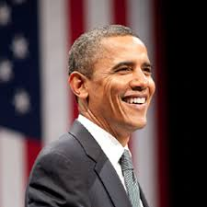
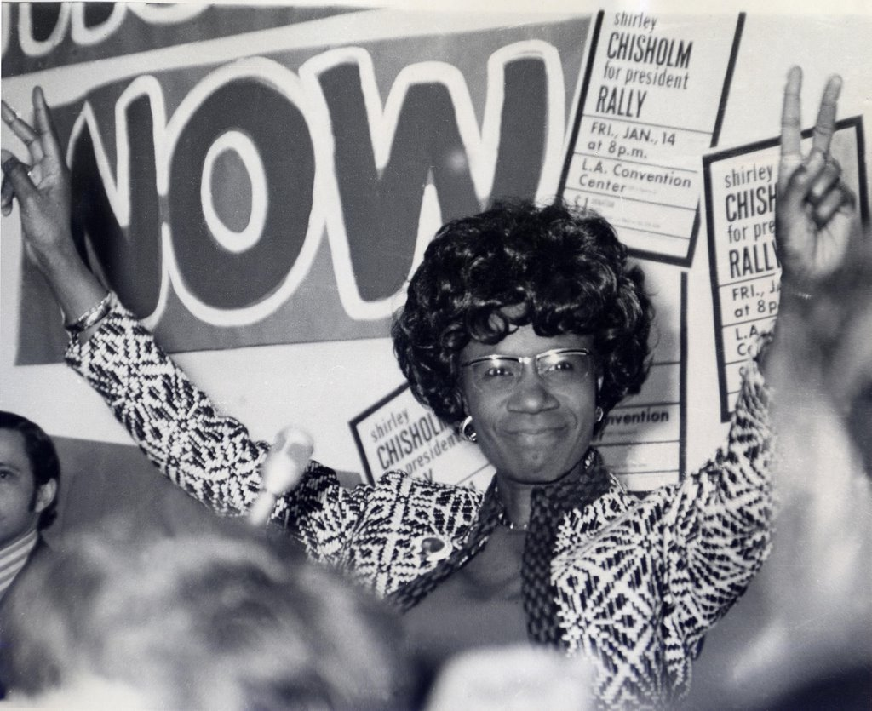
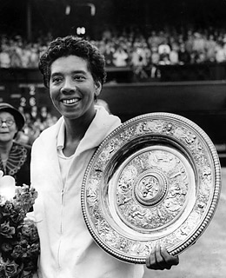
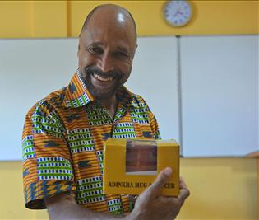
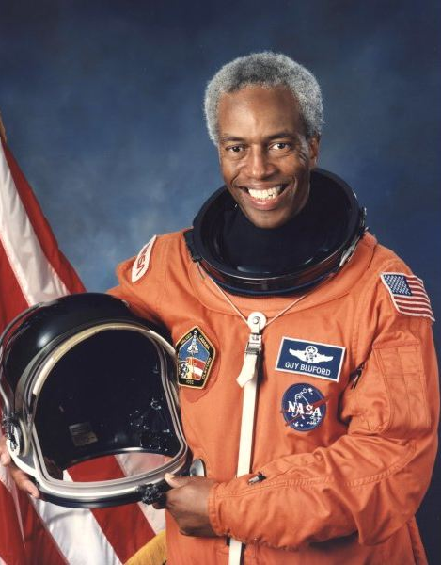
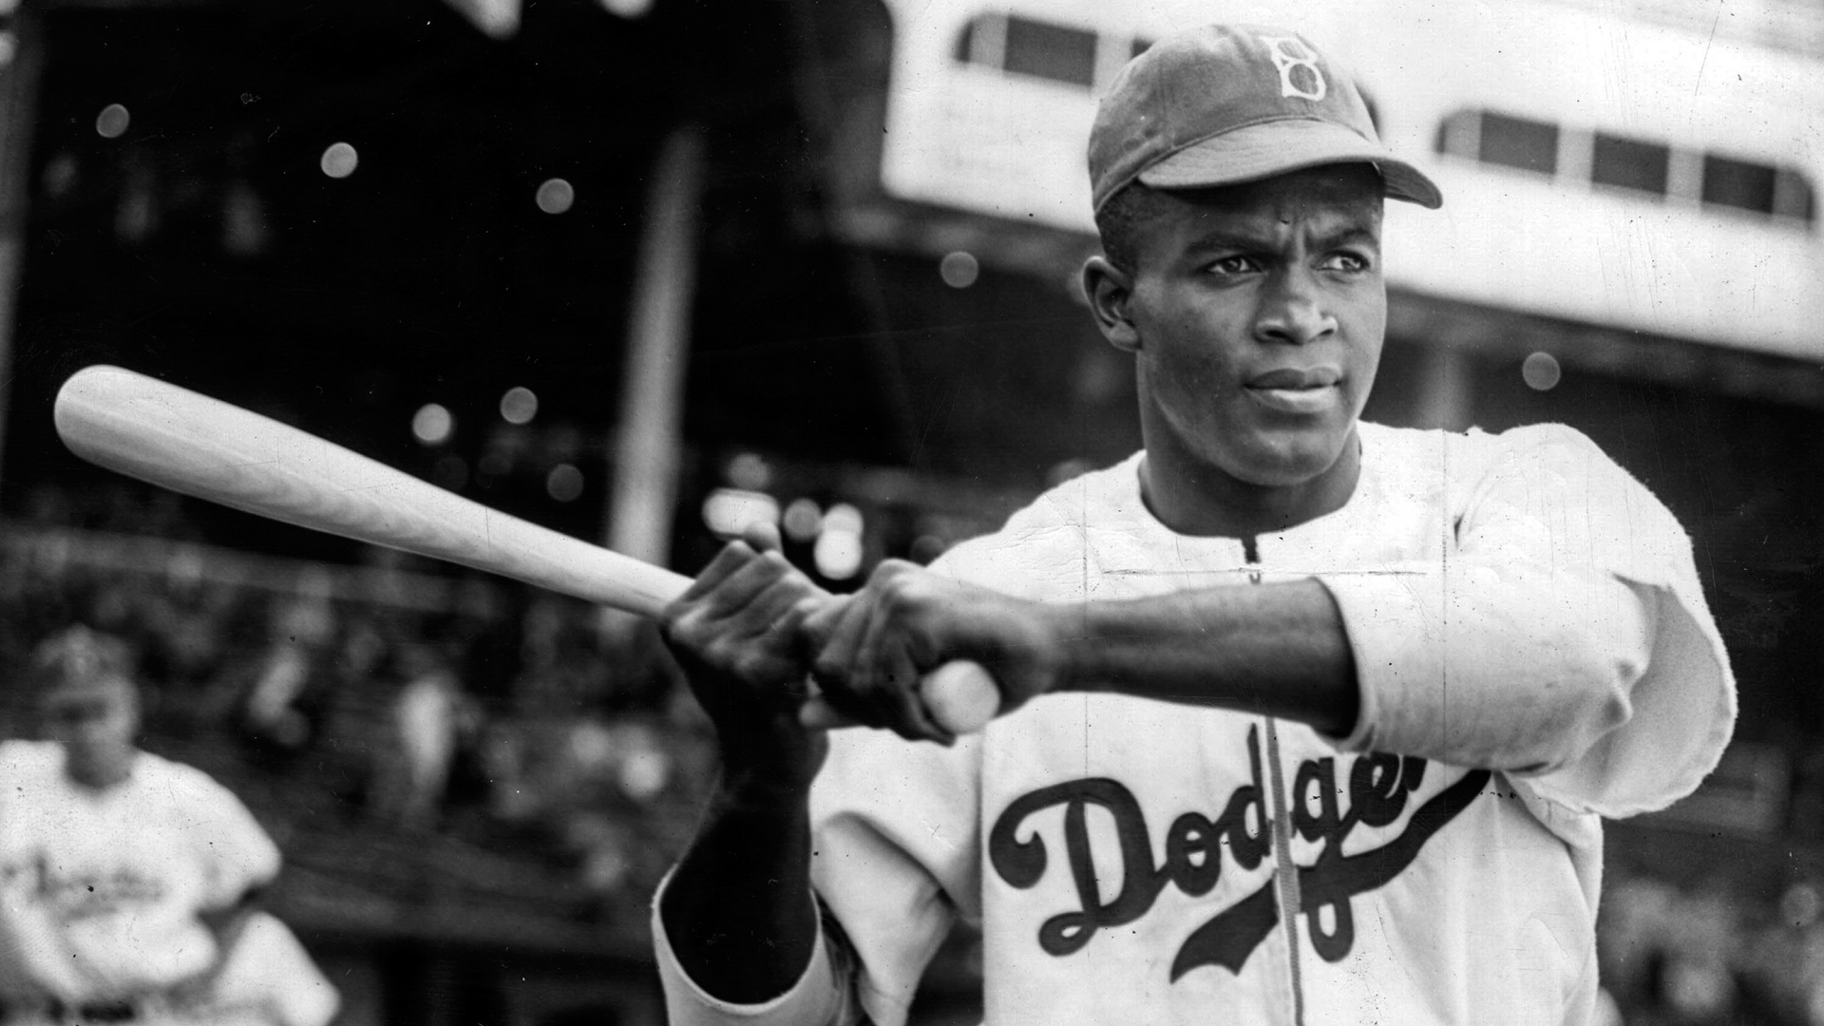
FIRSTS
Barack Obama
Shirley Chisholm
Althea Gibson
Clarence “Skip” Ellis
Guion “Guy” Bluford
Jackie Robinson
© 2022 The Regents of the University of Michigan
Notes:
This slide is about African Americans who were the “firsts” to do what they did because they had dreams and they did not let anybody stop them from reaching their dreams.
Barack Obama – the first African American President of the United States
Althea Gibson – the first African American to play in and win the Wimbledon tennis tournament
Shirley Chisholm – first African American woman elected to the United States Congress and first African American to run for president
Clarence “Skip” Ellis – first African American to receive a Ph.D. in computer science
Guion “Guy” Bluford – the first African American astronaut in space
Jackie Robinson – the first African American to play major league baseball
If these talented people had gotten off track by doing things that were bad for them our nation would have missed out on all their contributions!!!!!

Slide 10
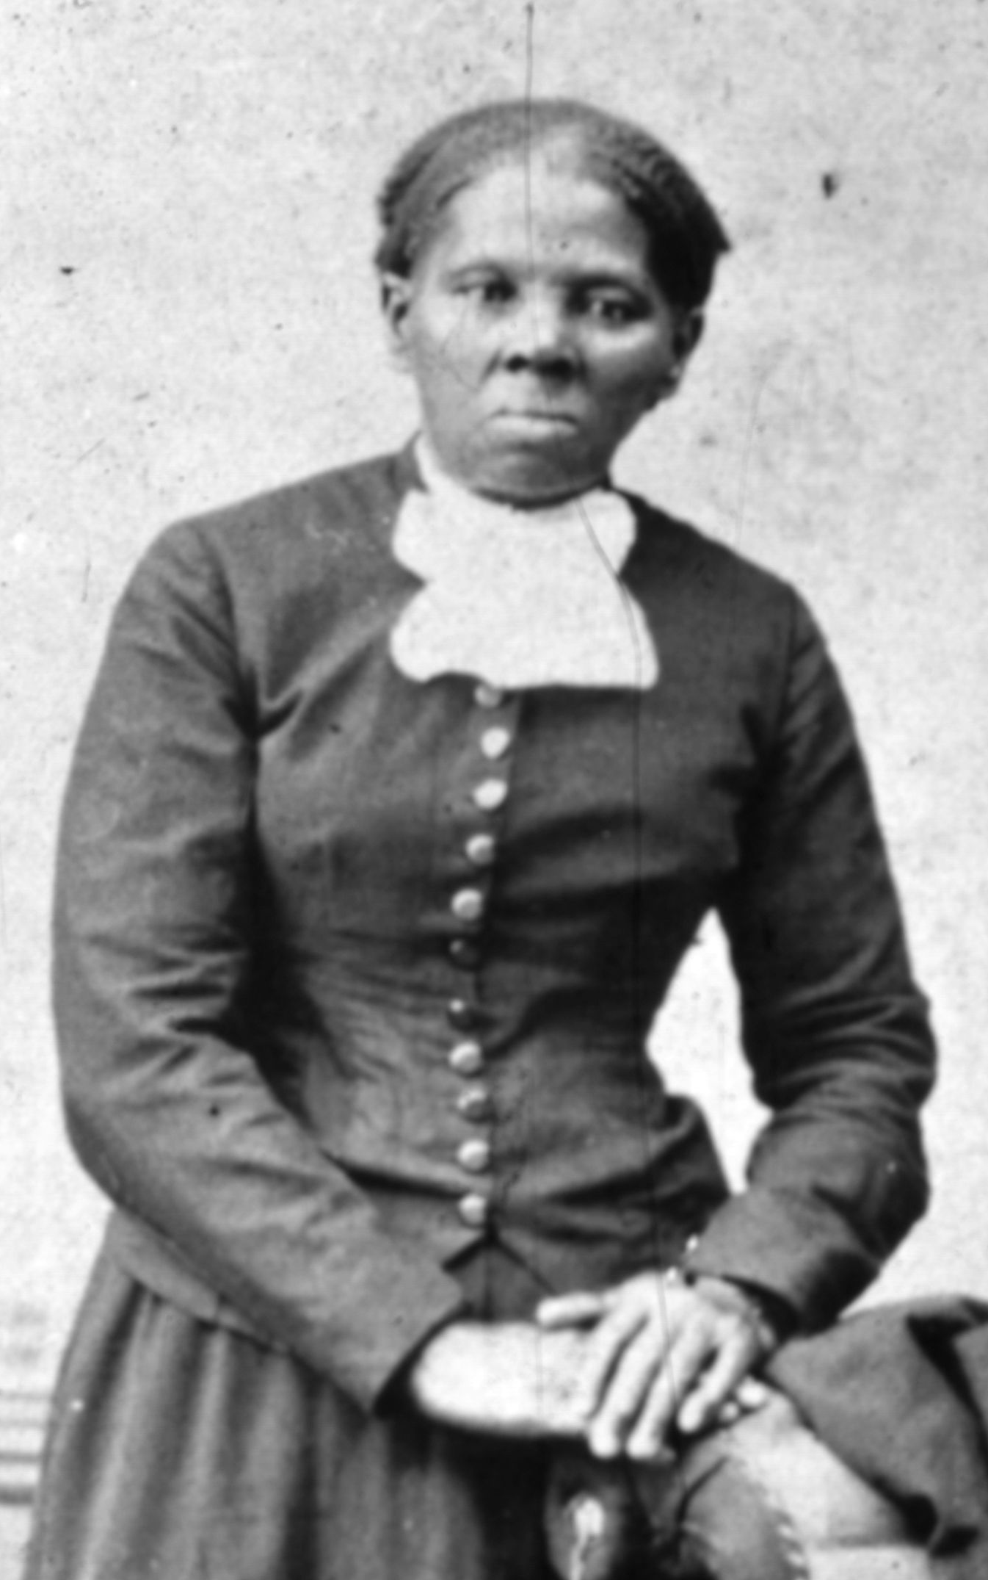
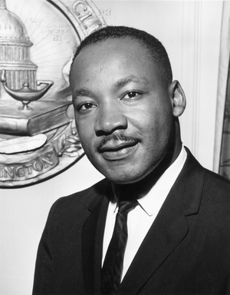
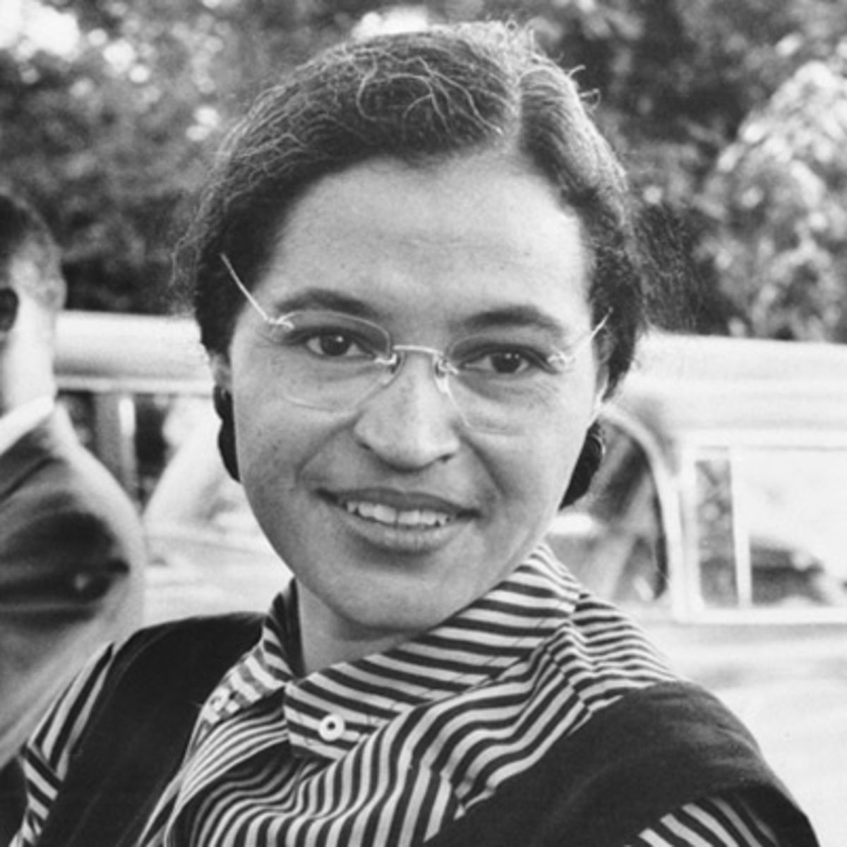
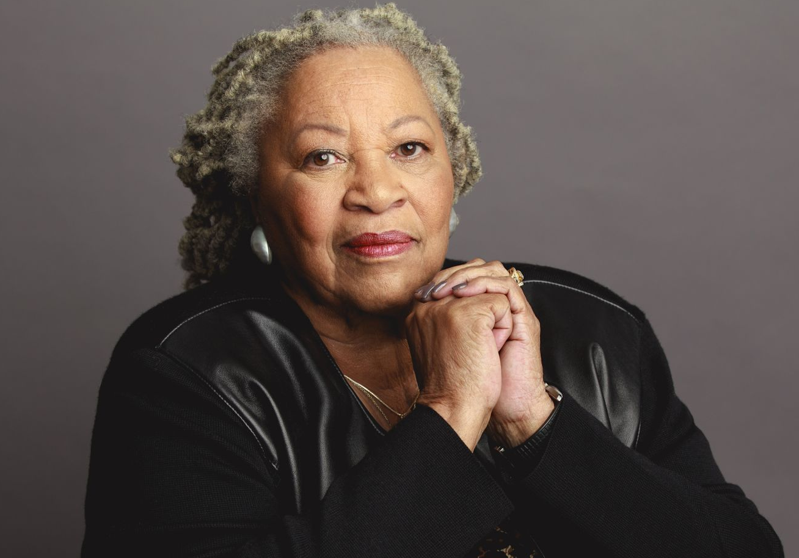
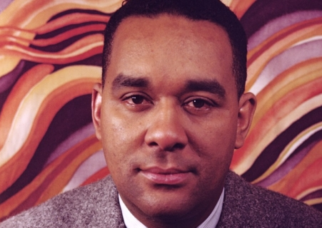
Reach for your Dreams
© 2022 The Regents of the University of Michigan
Rosa Parks
Dr. Martin Luther King Jr.
Harriet Tubman
Toni Morrison
Richard Wright
Notes:
This slide shows more men and women who reached their dreams.
Rosa Parks refused to give up her seat to a white person. Her civil disobedience spurred others on in the civil rights movement.
Harriet Tubman risked her life to save African American slaves escaping slavery in the south.
Toni Morrison and Richard Wright were talented writers whose words are read everyday. They dreamed of writing the great American novel, and they did it!
Martin Luther King Jr. dreamed of a nation where his children would not be judged by the color of their skin, but the content of their character. What does this mean? He died for his dream, but his dream still lives on in many people of all colors.
It’s important for you to have knowledge in order to take responsibility for your decisions and your health. Once you do all of this, your dreams can come true. What are some of your dreams?

Slide 11
What can I do?
Communicate with your Father
© 2022 The Regents of the University of Michigan
Notes:
We know that communication is not one sided, right? It is important to know what your dad thinks about you having sex at a young age, but it is also very important for your dad to know what you are thinking about.
Tell him what you are thinking about sex and let him know what your friends are telling you. Compare what your friends say to what your dad says, and ask him what he thinks about what your friends are telling you.
Even though it can be hard to talk to your dad, keep the lines of communication open. Continue to ask him questions when new things come up. And make sure you let him know when you are thinking about making a decision about sex and what you should do.
Always thank your dad for talking to you and giving you advice. Dads need encouragement and need to know that they are doing a good job just like you!

Slide 12
An Exercise
Write down four questions that you have about sex.
Be very specific about what you are asking.
Practice asking your questions with the group.
© 2022 The Regents of the University of Michigan
Notes:
Now it’s time to do an exercise. It’s one thing to tell you to ask questions, it’s another thing to think about questions that you really want answered. So now is your opportunity to say what you are thinking. I want you to think of 4 questions that you would like your father to answer about sexuality. Write them down.
Then think about why you picked the questions you did. Take notes so you can tell your dad why knowing this information is important to you.
Make sure you are very clear and specific about what you are asking (AFTER THEY HAVE HAD SOME TIME TO THINK OF QUESTIONS)…let’s practice asking these questions out loud. Does anyone want to share?
(WAIT FOR RESPONSES)
(AFTER DISCUSSION)
All of your questions were very good ones. You have taken the first step to talking with your father about anything! Later we will have an exercise that will give you even more practice. So be sure to hang onto your worksheets.
(END OF PRESENTATION)

Slide 13
References
Centers for Disease Control and Prevention (CDC). (2015). Youth Risk Behavior Surveillance – United States, 2015. Surveillance Summaries (65) 6: 1-174. Retrieved from https://www.cdc.gov/healthyyouth/data/yrbs/pdf/2015/ss6506_updated.pdf; https://world.wng.org/2016/07/cdc_african_american_teens_are_embracing_abstinence
© 2022 The Regents of the University of Michigan

Slide 14
Image Citations
Obama: https://lh6.googleusercontent.com/-2lJYGtfXKwQ/AAAAAAAAAAI/AAAAAAAB2HQ/QSmIw0nQN_c/photo.jpg
Bluford: http://img.bhs4.com/8e/e/8eefa6170fb5ae566c2e394aaefad248550bb8fd_large.jpg
Gibson: http://blackhistory-101.com/wp-content/uploads/2015/02/gibson-1.jpg
Ellis: https://connections.cu.edu/sites/default/files/wp-content/uploads/2014/05/clarence-skip-ellis-05-29-2014.jpg
Chisholm: https://s-media-cache-ak0.pinimg.com/originals/f5/6d/25/f56d2501352c76e92f8084c27e2e3270.jpg
Robinson: http://images.performgroup.com/di/library/sporting_news/b3/c9/jackie-robinson-041515-sn-ftrjpg_9piq61thvj0u1j5bb3hkalm0a.jpg?t=-1115572252
Parks: http://a1.files.biography.com/image/upload/c_fit,cs_srgb,dpr_1.0,h_1200,q_80,w_1200/MTE1ODA0OTcxNzQ5Mzc3NTQ5.jpg
Morrison: http://www-tc.pbs.org/wnet/americanmasters/files/2015/09/Toni-Morrison-TGS-e1442243714305.jpg
Tubman: http://assets.makers.com/field/image/HarrietTubmanherself_0.jpg
Wright: http://beinecke.library.yale.edu/sites/default/files/styles/landing_banner/public/signature_media/1078966_quarter.jpg?itok=JgCGvHc6
King: http://f.tqn.com/y/history1900s/1/L/Y/I/1/mlk.jpg
© 2022 The Regents of the University of Michigan

Slide 15
Credits
Special thanks to all the people who made and released these awesome resources for free:
Presentation template by SlidesCarnival
Photographs by Unsplash
© 2022 The Regents of the University of Michigan

