Slide 1

Substance Use Prevention
Fathers and Sons Program
© 2022 The Regents of the University of Michigan
Notes:
Facilitator Script
(Read the text in the boxes as you go through the PowerPoint slides)
Today we are going to talk about the effects of drugs and alcohol. We will focus on common signs and symptoms of substance use among young people in order to help you prevent substance use among your sons.
Some substances like alcohol, cigarettes, and marijuana cause a lot of problems for young people, so we are going to take a closer look at them.

Slide 2

Substance Use Among Young People
Statistics
“7.6% of young people ages 12-17 have met the criteria for dependence on and/or abuse of illicit drugs or alcohol.”¹
“African Americans are less likely than other racial/ethnic groups to abuse hard drugs. Yet, African Americans are disproportionately incarcerated for drug crimes.” ¹
© 2022 The Regents of the University of Michigan
Notes:
First, let’s go over some statistics about substance use among young people.
(READ SLIDE)

Slide 3
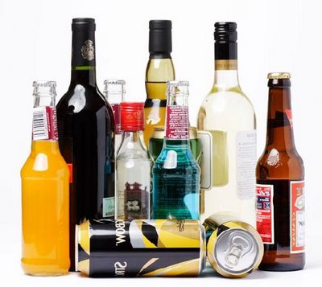
Alcohol
© 2022 The Regents of the University of Michigan
Notes:
The first substance we are going to talk about is alcohol.
Why do you think they make it illegal for young people to drink alcohol?
(WAIT FOR ANSWERS)
ANSWER: Alcohol has bad effects on the body and mind, especially for young people.
Let’s discuss some of the short and long term effects.

Slide 4

Short-Term Effects of Alcohol
Blurred vision
Hearing problems
Bad decision making
Bad breath
Silliness
Clumsiness
Hangovers
© 2022 The Regents of the University of Michigan
Notes:
Some of the short-term effects of alcohol include blurred vision, hearing problems, bad decision making, bad breath, silliness, clumsiness, and hangovers.

Slide 5
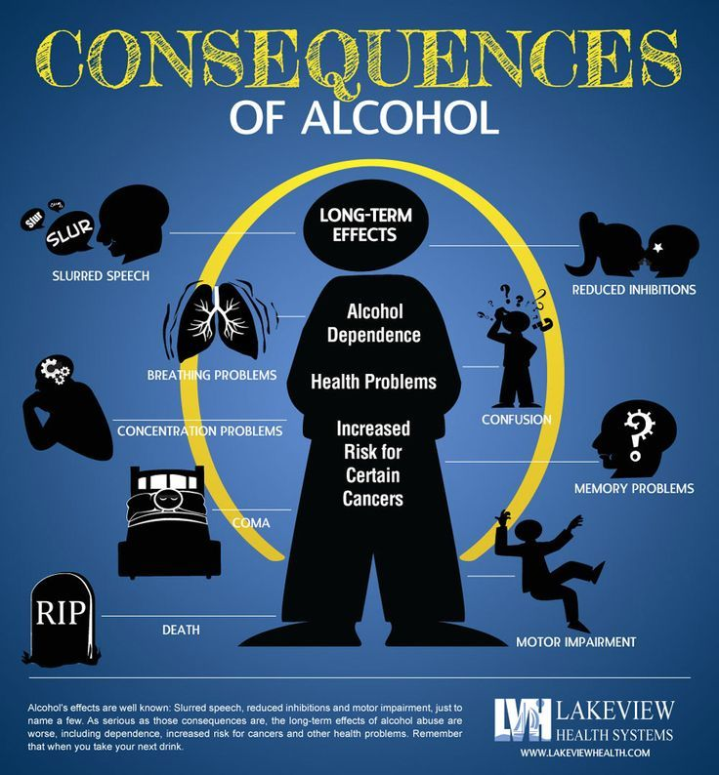
Long-Term Effects of Alcohol
Loss of appetite
Stomach problems
Skin problems
Memory loss
Liver, heart, and nervous system damage
© 2022 The Regents of the University of Michigan
Notes:
The long-term effects of alcohol include things such as loss of appetite, stomach problems, skin problems, memory loss, and liver, heart and nervous system damage.
Now let’s talk about another drug that seems to harm many young people, tobacco.

Slide 6
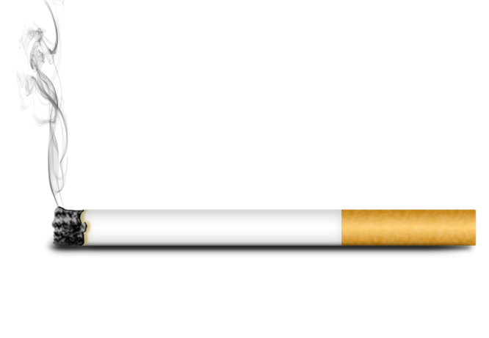
Tobacco
© 2022 The Regents of the University of Michigan
Notes:
As you know, there are a variety of products that contain tobacco including cigars, cigarettes, chewing tobacco/snuff, and pipes.

Slide 7
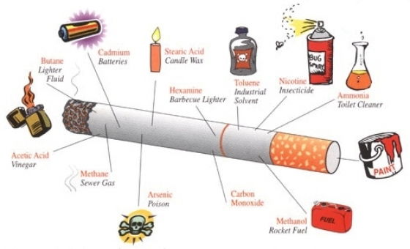
Effects of Tobacco
What’s in tobacco?
What does it do to the body?
Why do people smoke?
© 2022 The Regents of the University of Michigan
Notes:
What is in tobacco?³
Tobacco contains numerous chemicals like tar, lead, carbon monoxide which all can cause cancer. In addition, when these chemicals are let off in the body they clog up peoples lungs. Smoking is so bad for your health that tobacco products must have a warning label on them.
What does it do to the body? ³
Smoking doesn’t do anything good for the body. It makes the heart work faster, raises blood pressure, causes stomach ulcers, creates cancer, messes up skin, and leads to extensive mouth problems.
Why do people smoke? ³
One of the chemicals in tobacco is called nicotine. Nicotine is a very addictive chemical. Once it gets in the body a person feels like they physically and mentally need to have it in their system. Once a person feels this way it is very hard to quite smoking but it can be done. If the body never gets nicotine inside then a person will never experience cravings. This is why it’s not a good idea to ever experiment with cigarettes or any tobacco products.
So far we have talked about drugs that are legal for adults and illegal for children. Now let’s talk about marijuana.

Slide 8
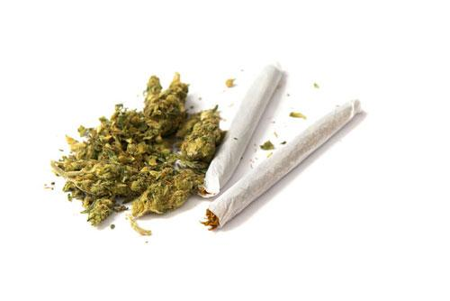
Marijuana
© 2022 The Regents of the University of Michigan
Notes:
In the state of Illinois it is still illegal for most adults ages 21 and over to possess marijuana anywhere in the state.⁶
Medical marijuana is only for a people with certain illnesses, usually chronic illnesses, and requires written certification from a doctor.⁷
Marijuana grows from the cannabis plant and contains hundreds of harmful chemicals.⁸
The main chemical is called THC and when it gets in the blood stream it effects the brain in many negative ways.⁸
Let’s look at some of the other effects of marijuana.

Slide 9

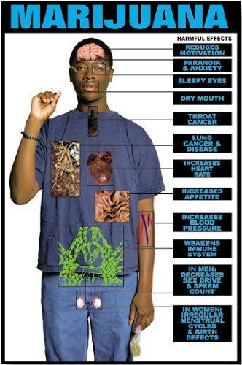
Short-Term Effects of Marijuana
Red itchy eyes
Excitement
Feel tired and worn out
The “munchies”
Confusion
Fail to remember things
Anxiety and panic attacks
Clumsinmess
Problems thinking
Fast heart beat
© 2022 The Regents of the University of Michigan
Notes:
Short-term effects of marijuana include…(READ SLIDE)
Can someone give me an example of how one of these effects could be bad for your sons?
(WAIT FOR ANSWERS)
Does anyone know how long these short term effects last?
(WAIT FOR ANSWERS)
ANSWER: The effects on the screen, are the strongest immediately after smoking, but some can last for days.
In addition to feeling these things a person who uses marijuana also faces health consequences.

Slide 10
Long-Term Effects of Marijuana
Drug addiction
Cancer
Brain damage
Lung damage
Slow thinking
Respiratory, immune, and reproductive system problems
Slow emotional development
© 2022 The Regents of the University of Michigan
Notes:
What do you think are some long term effects of marijuana use?
(CLICK SLIDE)
Many of these long term effects cannot be corrected, meaning smoking as a young person can be harmful for the rest of one’s life.

Slide 11
Common Signs and Symptoms of Teen Substance Use
Recognizing the Signs in Various Contexts
© 2022 The Regents of the University of Michigan
Notes:
“There’s no easy way to figure out if your teen is using drugs or alcohol.”⁴
“As you’ll see, many of the signs and symptoms of teen substance abuse are also, at times, typical adolescent behavior.”⁴
“Many are also symptoms of mental health issues, including depression or anxiety disorders.”⁴
Now we will provide a general overview of common signs and symptoms for substance use.

Slide 12
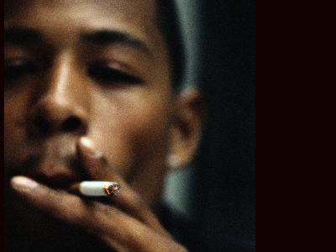
Personal Appearance
Messy, shows lack of caring for appearance
Poor hygiene
Burns on fingers or lips (from “joints” burning down)
© 2022 The Regents of the University of Michigan
Notes:
What are some signs of substance abuse that you may notice from your son’s personal appearance?
(WAIT FOR RESPONSES)
(CLICK SLIDE)
Your child’s personal appearance may reveal signs of substance use. For example poor hygiene or burns on their fingers or lips may be indicators of substance use.

Slide 13

Signs in the Home
Missing alcohol or cigarettes
Constant excuses for behavior
Breaking curfew
Spending a lot of time in their rooms
Lies about activities
Find the following: cigarette rolling papers, pipes, roach clips, plastic baggies
© 2022 The Regents of the University of Michigan
Notes:
You may also notice some signs that are home-related.
For example, missing alcohol or cigarettes, smells of different substances in the car or bottles, pipes, or bongs on the floor, the appearance of unusual containers or wrappers left on surfaces used to clean marijuana, and constant excuses for behavior may suggest substance use.

Slide 14

Signs at School
Sudden drop in grades
Sleeping in class
Truancy or always being late to school
Reduced memory and attention span
Poor attitude toward sports or other after school activities
Defiant of authority
© 2022 The Regents of the University of Michigan
Notes:
What about at school? What are some signs of substance abuse that you may present themselves at school?
(WAIT FOR RESPONSES)
(CLICK SLIDE)
Some possibilies include a sudden drop in grades, truancy or always being late to school, and a reduced memory or attention span.

Slide 15

Physical and Emotional Signs
Changes friends
Negative, argumentative, paranoid or confused
Sharing few if any of their personal problems
Doesn’t seem to be as happy as they used to be
Always needs money, or has excessive amounts of money
© 2022 The Regents of the University of Michigan
Notes:
There are also some physical and emotional signs that you may notice such as your son changing friends, acting paranoid or confused, always asking for money or having large amounts of money.

Slide 16

Personal Habits or Actions
Clenching teeth
Smell of smoke or other unusual smells on breath or on clothes
Avoiding eye contact
“Munchies” or sudden appetitie
Chewing gum or mints to cover up breath
© 2022 The Regents of the University of Michigan
Notes:
Some personal habits for actions that may be related to substance use are clenching teeth, the smell of smoke or other unusual smells on their breath or clothes, avoiding eye contact and the “munchies” as we mentioned earlier.

Slide 17

Behavioral Issues
Mood changes or emotional instability
Loud, obnoxious behavior
Unusually clumsy, stumbling, poor balance
Inability to focus
Slurred speech, rapid-fire speech
Unusually tired
Decreased motivation
© 2022 The Regents of the University of Michigan
Notes:
You may also observe a change in your child’s behavior such as mood changes, clumsiness and poor balance, the inability to focus and decreased motivation.

Slide 18
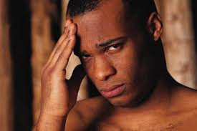
Health Issues
Nosebleeds
Frequent sickness
Sudden or dramatic weight loss or gain
Wetting lips or excessive thirst
Headaches
Sores, spots around mouth
© 2022 The Regents of the University of Michigan
Notes:
Finally, what are some health issues related to substance use that you think you should look out for?
(WAIT FOR ANSWERS)
(CLICK SLIDE)
Some potential health issues you may notice are nosebleeds, frequent sickness, wetting lips or excessive thirst, and sores or spots around your son’s mouth.

Slide 19

“Experiences and environments can increase or decrease the risk of substance use in children and adolescents.”¹
© 2022 The Regents of the University of Michigan
Notes:
In addition to knowing some of the signs and symptoms of teen substance use it is also important to understand that…(READ SLIDE)
This means that you play a big role in decreasing your son’s risk of substance use by being someone he can talk to and being their to support him.

Slide 20

The Value of Early Identification
© 2022 The Regents of the University of Michigan
Notes:
We share the different signs and symptoms of substance use because it can help you to identify substance use early on.
Early detection can help you to intervene and identify what type of services and support your son needs before their substance use worsens and creates long term consequences.¹

Slide 21
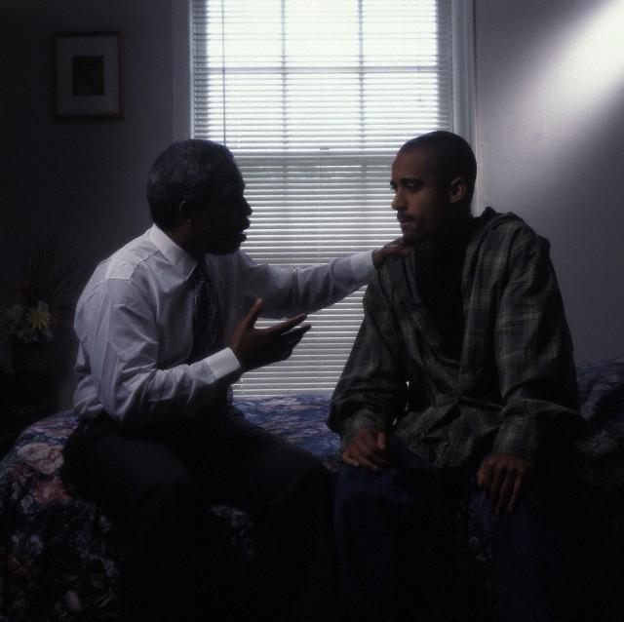
Don’t Dismiss the Warning Signs
“If you find that some of these warning signs fit your teen, take a look at the whole picture.”²
“Become more involved and find out what he’s doing, where he’s going and who he’s with.”²
“If you suspect your son is using drugs, start by talking to your son.”²
© 2022 The Regents of the University of Michigan
Notes:
In order to best support your son it is important not to dismiss the warning signs.
Here are some things to remember to help you catch the warning signs.
(READ SLIDE)

Slide 22

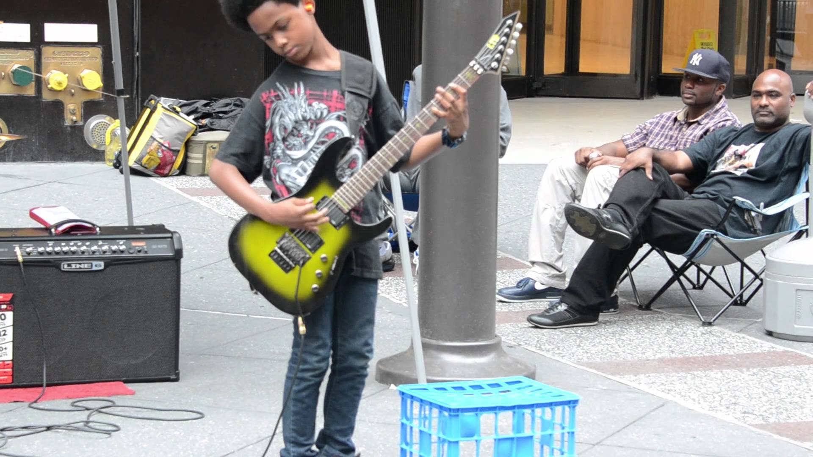
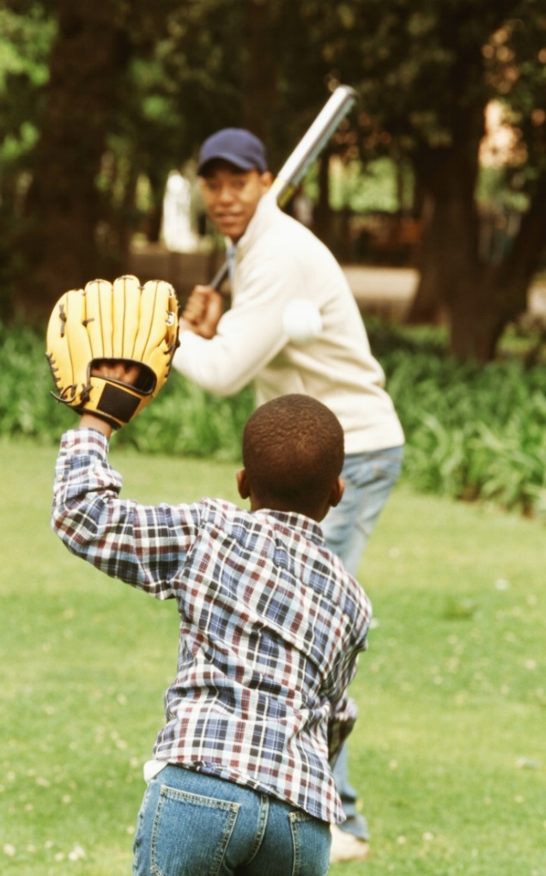

What’s your son’s anti-drug?
© 2022 The Regents of the University of Michigan
Notes:
One way for young people to avoid drugs is to get into things that make them feel good about themselves and what they can do.
Some people are good at sports, singing, playing a musical instrument, dancing, writing, drawing, speaking, and a lot of other things.
What are some things your sons are good at?
(WAIT FOR ANSWERS)
Thank you for sharing. One of the reasons it is important to address concerns about substance use is because it can have negative consequences that affect their talent and future goals.

Slide 23



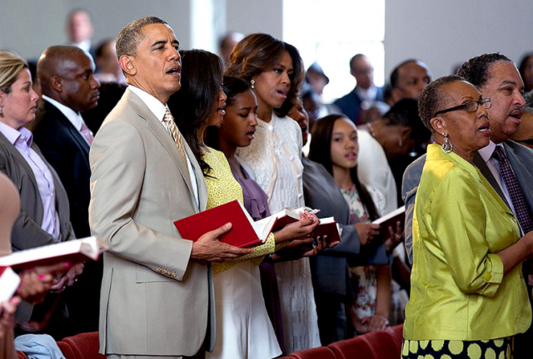

Where can you get help?
Friends
School Counselors
Family
Church Community
Local Health Department
Public Treatment Programs
© 2022 The Regents of the University of Michigan
Notes:
All these places offer help to people on drugs who would like to stop using them. They can help adults and kids who want to quit.
Can you think of any other places or people who might be able to help?
Now we are going to do an activity to help you talk to your father about drugs and alcohol.
ACTIVITY
A big part of helping your sons avoid drugs and other substances is being able to talk with them about your expectations and values. As a closing exercise, think about what you want to say to your son about alcohol, tobacco, marijuana or other drugs? Let’s use our Drug Activity Sheets to write down some things you want your son to know about substances like alcohol, tobacco, and marijuana. Make sure you are specific about what you want to say.
(END OF PRESENTATION)

Slide 24
References
Substance Abuse and Mental Health Services Administration (SAMHSA). (2011). Identifying Mental Health and Substance Use Problems of Children and Adolescents. (HHS Publication No. SMA 12-4670). Rockville, MD. Retrieved from http://store.samhsa.gov/shin/content/SMA12-4700/SMA12-4700.pdf
Witmer, D. (2016). Teen Drug Use Warning Signs. Very Well. Retrieved from https://www.verywell.com/teen-drug-use-warning-signs-2606192
American Lung Association. (2016). Smoking Facts. Retrieved from http://www.lung.org/stop-smoking/smoking-facts/whats-in-a-cigarette.html?referrer=https://www.google.com/
Partnership for Drug-Free Kids. (n.d.). Is Your Teen Using? Signs and Symptoms of Substance Abuse. Retrieved from http://www.drugfree.org/resources/is-your-teen-using-signs-and-symptoms-of-substance-abuse/
Foundation for a Drug-Free World. (n.d.). The Truth About Alcohol, Marijuana, and Drugs. Retrieved from http://www.drugfree.org/resources/is-your-teen-using-signs-and-symptoms-of-substance-abuse/
Marijuana Policy Project. (2017). Illinois’s General Assembly reconvenes. Retrieved from https://www.mpp.org/states/illinois/
State of Illinois. (2017). Medical Cannabis Pilot Program. Retrieved from https://www.illinois.gov/gov/mcpp/pages/default.aspx
National Institute on Drug Abuse. (2015). Marijuana: Facts for Teens. Retrieved from https://www.drugabuse.gov/sites/default/files/teens_brochure_2013.pdf
© 2022 The Regents of the University of Michigan

Slide 25
Image Citations
https://images.jg-cdn.com/image/cf8623d1-38f7-482b-99cc-28661462d8fb.png?template=fundraisingpagegalleryxl
http://www.drugfree.org/wp-content/uploads/2010/09/alcohol11.jpg
http://www.helpguide.org/images/harvard/boy-drinking-350.jpg
https://www.lakeviewhealth.com/images/infographics/consequences-of-alcohol-infographic.jpg
http://pngimg.com/upload/cigarette_PNG4751.png
http://www.childrensaidsociety.org/files/imagecache/header-image/images/header-images/smoking_impact.jpg
https://d14rmgtrwzf5a.cloudfront.net/sites/default/files/joints_shutterstock-52960849.jpg
https://usercontent2.hubstatic.com/13192489_f520.jpg
https://images-na.ssl-images-amazon.com/images/I/51GY030CfJL.jpg
http://www.blackradionetwork.com/images/headline/1304360452.jpg
http://images.all-free-download.com/images/graphicthumb/different_houses_design_elements_vector_534175.jpg
http://gopalbhandari.com.np/wp-content/uploads/2014/09/gopal-education.jpg
http://nationofimmigrators.wp.lexblogs.com/wp-content/uploads/sites/224/2012/03/sad-teen-boy.jpg
http://www.newyorker.com/wp-content/uploads/2016/10/161024_r28888-865x1200-1476393605.jpg
https://cdn.psychologytoday.com/sites/default/files/field_blog_entry_images/BET-teens-predict-to-die-young-depression.jpg
http://madamfelicia.org/wp-content/uploads/2015/03/headache-600x400.jpg
http://www.kairosmentalhealth.com/images/african_depression_pic.jpg
http://youth.gov/sites/default/files/topic_substanceAbuse_1.jpg
https://opinionatedmale.files.wordpress.com/2013/03/blackdadsontalking.jpg?w=353&h=352
https://i.ytimg.com/vi/g2M7Frp85Ck/maxresdefault.jpg
http://i.dailymail.co.uk/i/pix/2016/03/27/19/32990BBD00000578-3511568-image-a-30_1459102675778.jpg
https://i1.wp.com/watercoolerconvos.com/wp-content/uploads/2015/11/african-american-students1.jpg
http://www.americanluster.com/assets/images/Articles/school_counsellor_012016.gif
http://optimizeottawa.com/wp-content/uploads/bfi_thumb/main_home1_770x350-mxwaximpuwer2u3sccmaxj9qo9i7xibg6d0dm37c18.jpg
© 2022 The Regents of the University of Michigan

Slide 26
Credits
Special thanks to all the people who made and released these awesome resources for free:
Presentation template by SlidesCarnival
Photographs by Startup Stock Photos
© 2022 The Regents of the University of Michigan

