Slide 1

Adolescent Development
Fathers and Sons Program
© 2022 The Regents of the University of Michigan
Notes:
Facilitator Script
(Read the text in the boxes as you go through the PowerPoint slides)
Today we are going to talk about adolescent development.

Slide 2
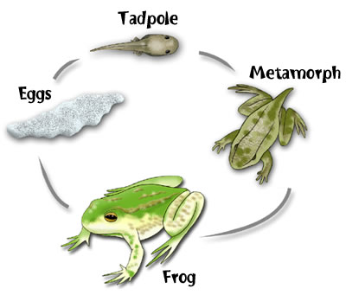
Adolescence
Is a time of biological, psychological and social changes
Is an exciting time of life with the main purpose to prepare children for adult roles
Is a time to help children pass from immaturity into maturity
© 2022 The Regents of the University of Michigan
Notes:
Adolescence is a time of change, including biological, psychological, and social changes in one’s life.
Similar to the development of a frog, humans also experience changes to prepare for adult roles.

Slide 3
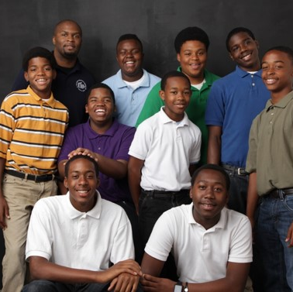
When does it happen?
Adolescence ranges from ages 11-21
Early
Middle
Late
© 2022 The Regents of the University of Michigan
Notes:
We have to think about where children are developmentally to know what to expect. Most often we think about adolescents in three age groups.
Those who are 11-14 years old are considered to be in early adolescence.¹
Those 15-17 years old are considered to be in middle adolescence, and those 18-21 years old are considered to be in late adolescence.¹
8-10 year olds are considered to be in preadolescence, while those who are 22-24 year olds are sometimes considered to be young adults.
What we know for sure is that adolescence begins at puberty and ends at maturity.

Slide 4
What makes adolescence a unique stage of life?
The beginning of PUBERTY
  Biological changes
The ability to think in more complex ways
  Psychological or cognitive changes
The transition into new roles in the family and in society
  Social changes
© 2022 The Regents of the University of Michigan
Notes:
Puberty means the changes in the young person’s physical appearance and the ability to have children. As the body changes, the way the adolescent feels about himself can change and relationships within the family can change.¹
Cognitive changes refers to more sophisticated ways of thinking about things. Younger adolescents are more concrete or precise in their thinking. That is, they only see things as black or white. Older adolescents can see things in more abstract ways or see things that require more reasoning. They are able to see things in a more logical way. For example, they are able to plan ahead, solve moral dilemmas, and know how they feel about politics and religion better than younger adolescents do. How adolescents think can also affect family relationships because of the kind of day-to-day decisions they make for themselves.¹
Social transitions involve changes in rights, privileges, and responsibilities for the adolescent. Relationships with family and friends change. Adolescents tend to want to spend more time with friends as they get older. But the family remains important in the adolescent’s life, especially when he is trying to make important decisions.¹

Slide 5
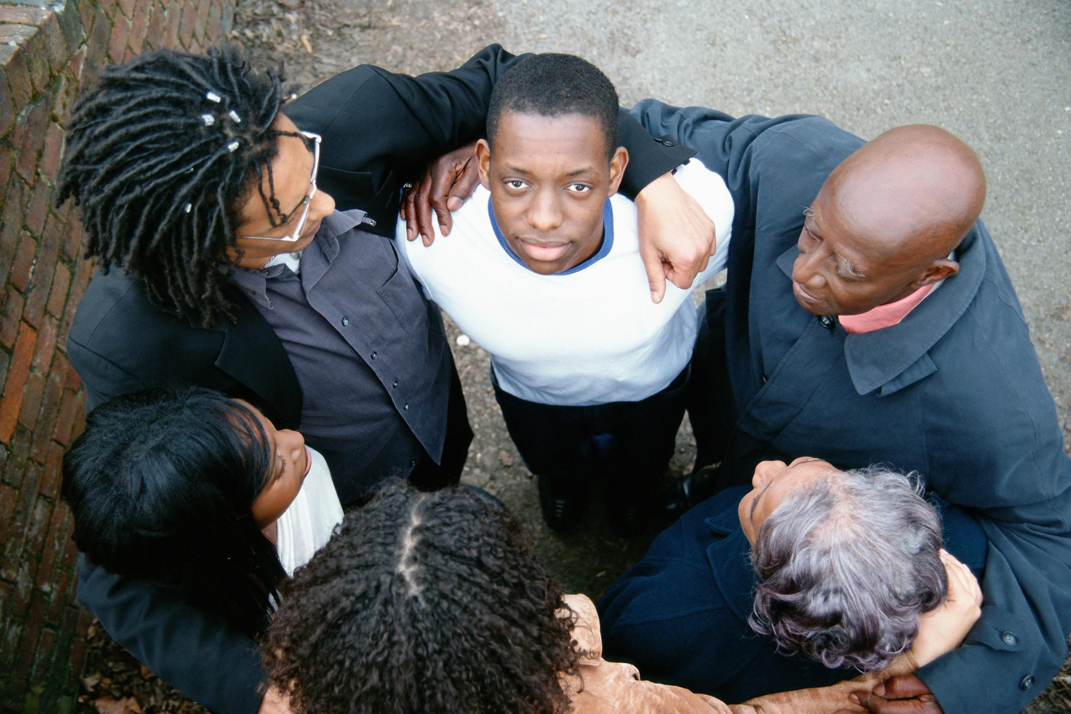
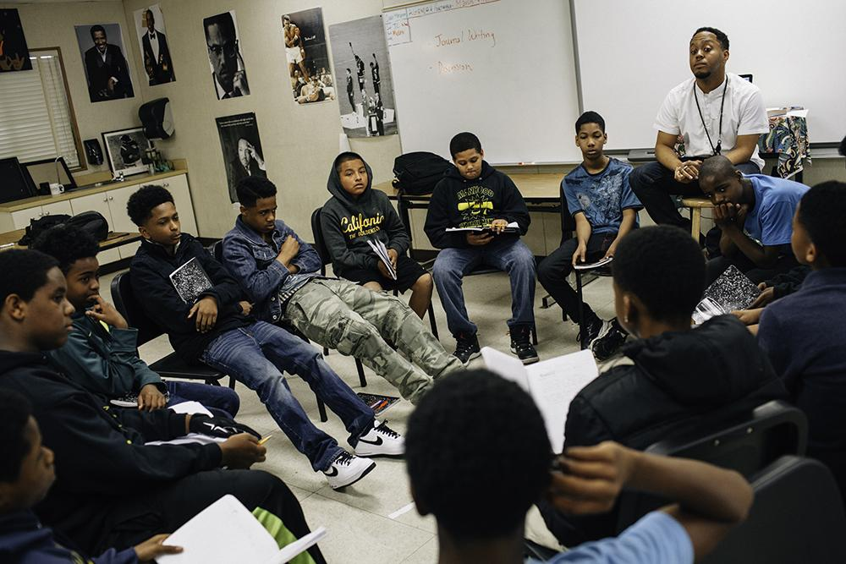

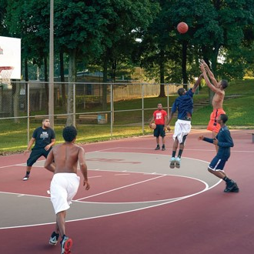
What are important environments for adolescent development?
Family
Peers
Schools
Neighborhoods
© 2022 The Regents of the University of Michigan
Notes:
Adolescent development is affected by what the family does, by what happens in peer groups, by what happens in school and by what happens in neighborhoods.
We will come back to ways of thinking about these issues when we talk about parenting and social support in sessions five and six.

Slide 6

Why is adolescence a time when some people make bad health decisions?
Need for guidance from caring adults
Need for better negotiation skills
© 2022 The Regents of the University of Michigan
Notes:
Some adolescents don’t have enough guidance from family and caring adults to help them make better health decisions and they end up deciding to smoke cigarettes or use drugs and alcohol, or even use violence to get what they want.
Others don’t know how to say no when someone else wants them to do unhealthy things. We will talk about how to make better decisions about these things throughout the program.
(END OF PRESENTATION)

Slide 7
References
American Academy of Pediatrics. (2015). Stages of Adolescence. https://www.healthychildren.org/English/ages-stages/teen/Pages/Stages-of-Adolescence.aspx
© 2022 The Regents of the University of Michigan

Slide 8
Image Citations
http://www.ourclassweb.com/projects/webquest_frogs_lifecycle.jpg
http://s.newsweek.com/sites/www.newsweek.com/files/2015/03/23/0327oakland01.jpg
© 2022 The Regents of the University of Michigan

Slide 9
Credits
Special thanks to all the people who made and released these awesome resources for free:
Presentation template by SlidesCarnival
Photographs by Unsplash
© 2022 The Regents of the University of Michigan

