Slide 1
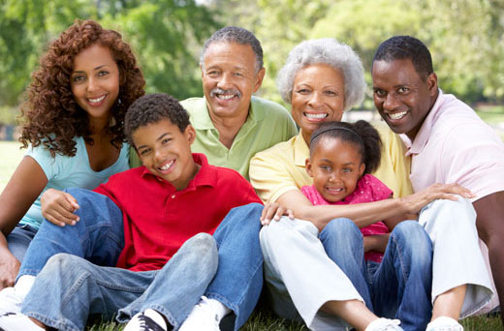
Family Diversity
African American Families
Fathers and Sons Program
Notes:
Facilitator Script
(Read the text in the boxes as you go through the PowerPoint slides)
African American culture represents a distinct ethnic and racial experience that is unique for a number of reasons.
For example, our African legacy, the experiences of slavery, racism and discrimination all combine to influence who we are today. Even with these common experiences, there are a lot of differences among African American families in this society.
Today, we are going to discuss the history and present the state of African American families.
I want everyone to take a moment to think about African American families.
(CLICK MOUSE)

Slide 2
African American Families
What comes to mind when you think of African American families?
Notes:
Young men, give me some words to describe the family?
Fathers, what are some of the benefits of family?
(PRAISE ANSWERS)
There is no such thing as an “African American family”. There is a tendency in this country for a lot of people to think that all Black people are alike. When they do this, they often use stereotypes to define what African American families are like. (ASK A SON TO HELP YOU DEFINE STEREOTYPES). But there are a lot of differences in values, characteristics, and life styles based on religious background, age, education, where people live, marital status, and a number of other experiences that families have.
(CLICK MOUSE)

Slide 3

Father and Sons Families
Notes:
What all this means is that there are different types of African American families. The Fathers and Sons Program only involves one type of family.
Can anyone tell me what type of family that is?
(Hint: something everyone in the room has in common)
(WAIT FOR ANSWERS)
African American families are diverse in nature. Historically, African Americans have valued marriage and favored the traditional two-parent family.
(CLICK MOUSE)

Slide 4
African American Families
Notes:
In 1890, 80% of African American families were headed by two parent households even though many had started life in forced family separation from slavery.¹
Which color represents the 80% on the top picture?
In 2015, only 34% are married.¹
(CLICK MOUSE)

Slide 5
African American Families
CHALLENGES
STRENGTHS
Notes:
We know that many families today face challenges in raising and providing for their children. During this program we are going to talk about ways to make some of these challenges easier for both fathers and sons who may face special challenges because they don’t live together. So let’s just take a little time tonight to name some of the strengths of African American families that we might be able to build on as you go through the program.
What are some strengths?
(NOTE: FOCUS ON THESE ANSWERS)³
-Religious beliefs can provide guidance in life
-The belief in the value of education as a a way to a
better future
-The strength of the extended family support
-Flexible family roles
(CLICK MOUSE)

Slide 6

African American Families
Notes:
What we can appreciate about African American families is that they are unique. They don’t look alike. No matter what your family arrangement is, everyone - mothers, grandparents, and fathers are all important people when it comes to raising African American children.
What are some questions or comments that come to mind when you think about your family?
(END OF PRESENTATION)

